Slide 1





Functional imaging of insomnia disorder
across wakefulness and sleep
Ph.D. Candidate: Yu-Peng Guo
Peking University Sixth Hospital
Peking University Institute of Mental Health
Notes:
Functional imaging of insomnia disorder across wakefulness and sleep.

Slide 2
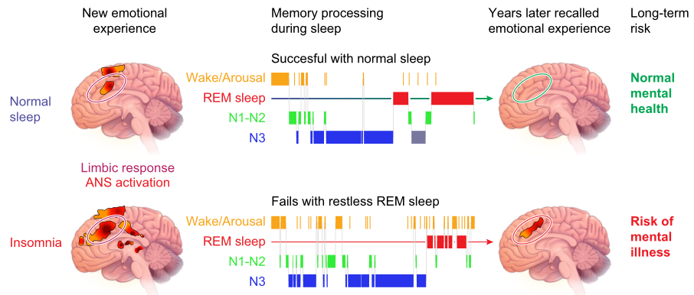
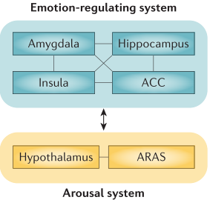
Epidemiology and brain mechanism of insomnia
Insomnia is the second most common mental disorder, occurs in up to a third of the adult population worldwide
The integrated findings suggest that the vulnerability to develop insomnia could rather be found in brain circuits regulating emotion and arousal than in circuits involved in circadian and homeostatic sleep regulation.
Van Someren, Physiol Rev, 2021
Morin, et al., Nat Rev Dis Primers, 2015
Perlis, et al., Lancet, 2022
Notes:
Insomnia is the second most common mental disorder, occurs in up to a third of the adult population worldwide. The mechanism of ID is still not clear. Previous study found that the novel negative event elicited a limbic response, including the anterior cingulate cortex, both in normal sleepers and people with insomnia. However, the difference is, the nagative experiences from the distant. These memories no longer activated a limbic response in normal sleepers, while people with insomnia responded as it had just now happened. These finding suggests that failing neutralization of emotional distress could contribute to the development of insomnia. The integrated findings suggest that the vulnerability to develop insomnia could rather be found in brain circuits regulating emotion and arousal than in circuits involved in circadian and homeostatic sleep regulation.

Slide 3
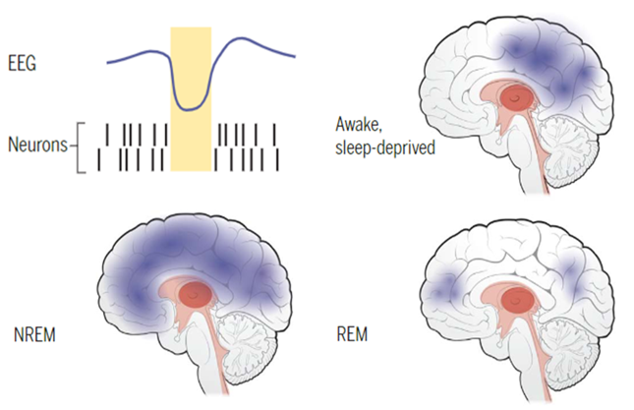
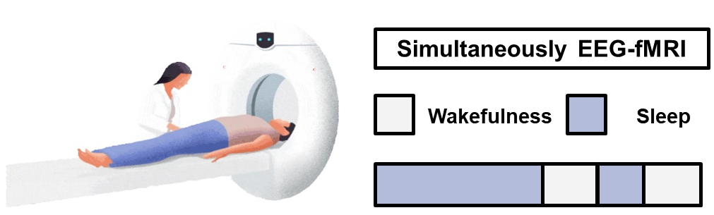
Progress in our understanding of brain dysfunctions in insomnia across wakefulness and different sleep stages has been limited
Sleep is characterized by dynamic variations in brain activity over time
Using simultaneous EEG-fMRI can identify the brain functional networks across wakefulness and different stages in patients with insomnia disorder
With this advantage, we can also illustrate brain activation in relation to characteristic sleep events, such as spindles, in patients with insomnia disorder
Lewis, et al., Science, 2021
Notes:
Sleep is characterized by dynamic variations in brain activity over time. The brain function across wakefulness and sleep may display impairments in patients with insomnia, However, most functional imaging study was conducted in daytime wakefulness, Progress in our understanding of brain dysfunctions in insomnia across wakefulness and different sleep stages has been limited. Using simultaneous EEG-fMRI can identify the brain functional networks across wakefulness and different stages in patients with insomnia. With this advantage, we can also illustrate brain activation in relation to characteristic sleep events, such as spindles

Slide 4

Simultaneous electroencephalography––functional magnetic resonance imaging (EEG-fMRI) during wakefulness and sleep
Wakefulness
Sleep
Five-minute epoch
Five-minute
Five-minute
Five-minute
Five-minute
Five-minute
Five-minute
Five-minute
Five-minute
Five-minute
Five-minute
Five-minute
The model of linear mixed-effect: includes variates of stage (wake, N1, N2, N3), sessions, groups, age, sex and educational years
EEG-fMRI
The brain network characteristics of insomnia disorder across wakefulness to sleep
Notes:
So, by using EEG-fMRI scanning, we collected fMRI sessions from wakefulness and different sleep stages. And develop linear mixed effect model to identify the group and stage interaction of functional network, we also extracted the functional activation in relation to characteristic sleep events. Our objective was to illuminate the abnormal brain network of insomnia wakefulness to sleep

Slide 5
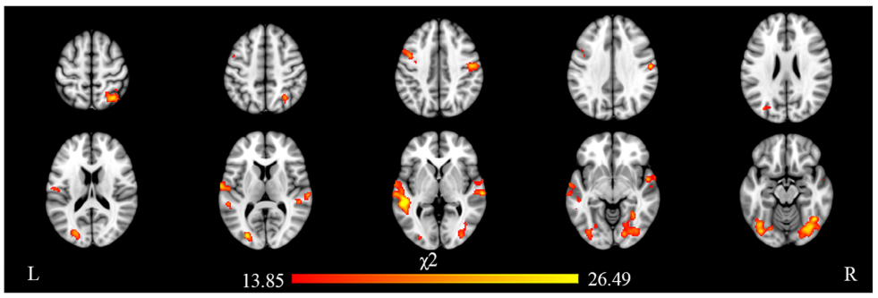
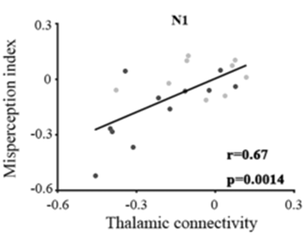
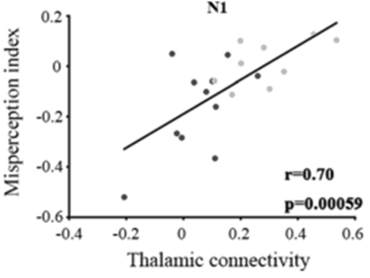
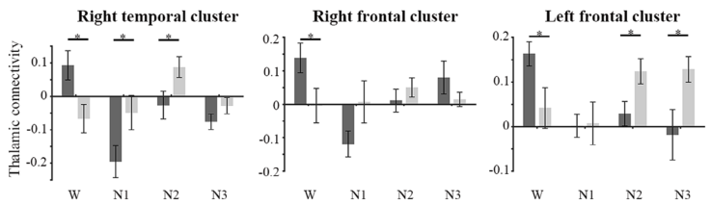
Altered thalamic connectivity in insomnia disorder during wakefulness and sleep
A group-by-stage interaction of thalamic connectivity was observed at widespread cortical regions
The thalamocortical connectivity was significantly correlated with the misperception index
Zou et al., Hum Brain Mapp, 2020
Notes:
By using EEG-fMRI methods, our group demonstrated the altered thalamic connectivity in insomnia disorder during wakefulness and sleep and the relationship between thalamocortical connectivity and the sleep misperception. Different patterns of thalamic connectivity in several cortical regions was found in wakefulness and Non-REM sleep in insomnia group, and the thalamocortical connectivity was positively associated with the Sleep Misperception index.

Slide 6
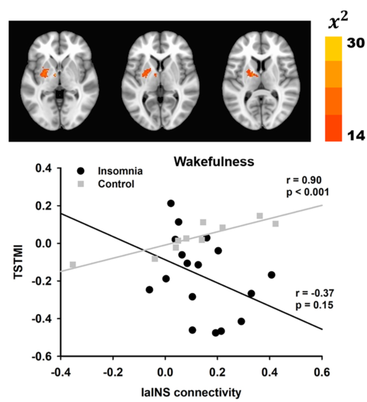
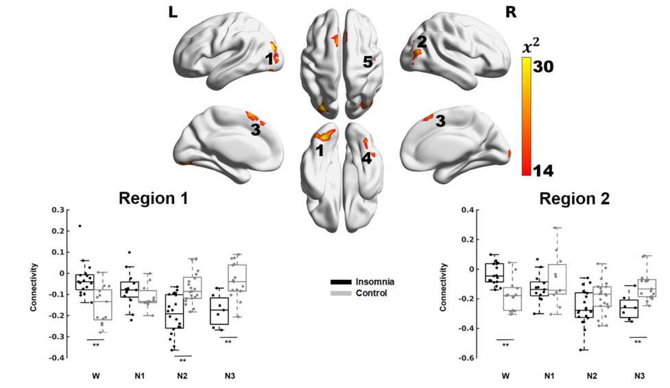
Sleep discrepancy is associated with alterations in the salience network in patients with insomnia disorder
Li et al., Neuroimage Clin, 2022
Notes:
And we also revealed that the sleep discrepancy is associated with alterations in the salience network in patients with insomnia disorder. Thus far, our data give extra evidences of cortical hyperarousal across wakefulness and sleep in insomnia.

Slide 7
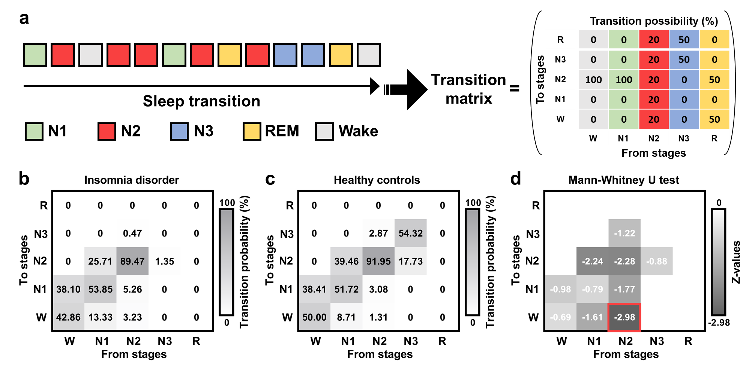
Abnormal connection between the ACC and cerebellum predicted a greater likelihood of awakening during N2 sleep in patients with insomnia
Unpublished data
Notes:
Difficulty maintaining sleep (waking up often during the night) is the most common subtype of insomnia. But the index represented the difficult in the sleep maintain is lacking. In this study, we develop a trasition matrics among different sleep stages. We found that patients with insomnia displayed a higher likelihood of transitioning from N2 to wakefulness

Slide 8

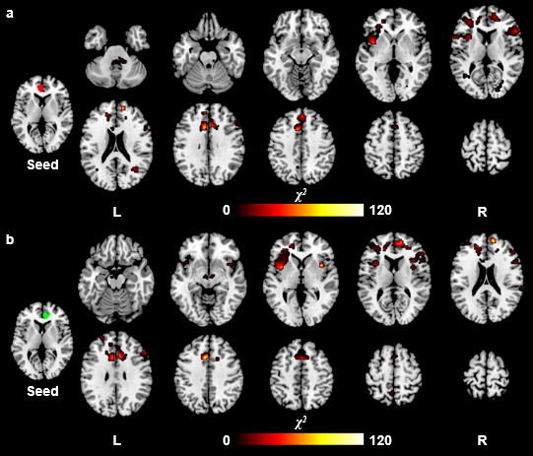
Abnormal connection between the ACC and cerebellum predicted a greater likelihood of awakening during N2 sleep in patients with insomnia
Unpublished data
Notes:
We next found the Abnormal connection between the ACC and three subcortical regions including inferior frontal cortex and cerebellar in patients with insomnia disorder.

Slide 9
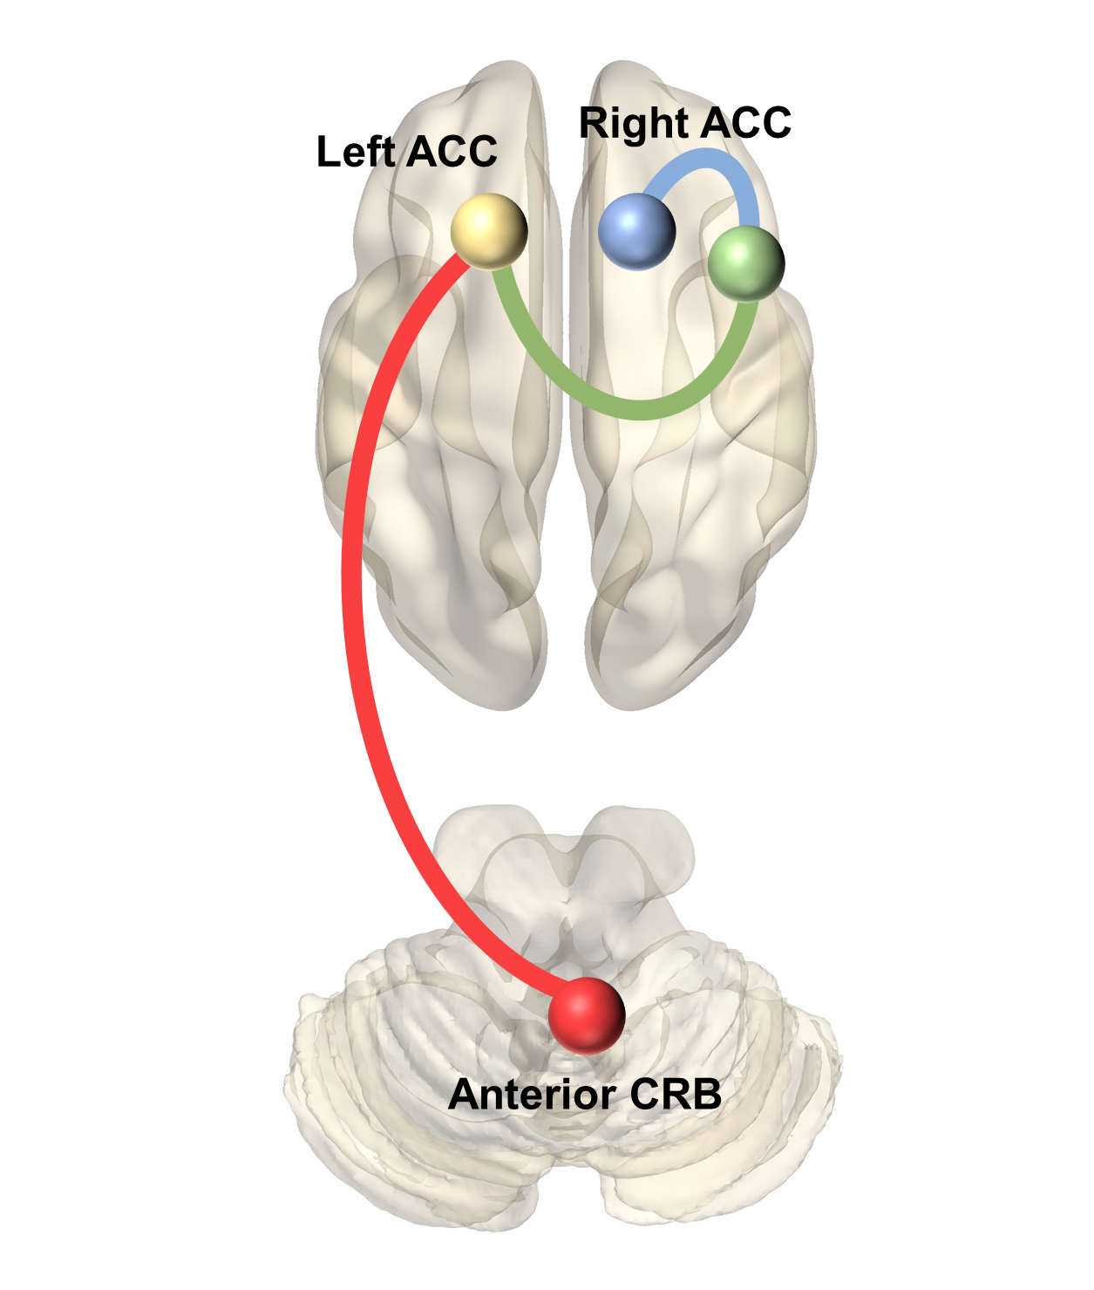
Abnormal connection between the ACC and cerebellum predicted a greater likelihood of awakening during N2 sleep in patients with insomnia
Unpublished data
Notes:
the Abnormal connection between the ACC and cerebellum predicted a greater likelihood of awakening during N2 sleep in patients with insomnia

Slide 10
EEG-fMRI study of insomnia: new images and fresh challenge
These findings illuminate the coupling between the dynamic transition of sleep stages and the functional organization of the brain
Our study suggest that the prominent abnormal neural representation observed across wakefulness and sleep that characterizes the coordination between the limbic system and arousal structures may hinder the maintenance of sleep in insomnia
We only obtained EEG-fMRI data in the early period of the sleep-wake cycle due to scan length limitations and subject compliance. Future studies need to overcome this disadvantage. Successful recording of EEG-fMRI data throughout the entire night may provide adequate fMRI epochs containing REM sleep, which will advance our understanding of the neural mechanism underlying insomnia
Notes:
These findings illuminate the coupling between the dynamic transition of sleep stages and the functional organization of the brain. Our study suggest that the prominent abnormal neural representation observed across wakefulness and sleep that characterizes the coordination between the limbic system and arousal structures may hinder the maintenance of sleep in insomnia. However, we only obtained EEG-fMRI data in the early period of the sleep-wake cycle due to scan length limitations and subject compliance. Future studies need to overcome this disadvantage. Successful recording of EEG-fMRI data throughout the entire night may provide adequate fMRI epochs containing REM sleep, which will advance our understanding of the neural mechanism underlying insomnia

Slide 11


北京大学第六医院
睡眠医学科
Thank you

